Slide 1


ML - Weather
ML - Weather
A Smart Weather Station System
Automation Challenge II Project
Team Data Pirates – M H A Ahmed , N M Hafeel
BSc Eng.(Hons) in Computer Science and Engineering
University of Moratuwa (UG)
Mentor - Dr. Kutila Gunasekara

Slide 2

ML - Weather
Agenda
Problem Background
Proposed Solution
Demonstration
Limitation & Future Work

Slide 3

ML - Weather
Problem Background
NEED FOR A SMART WEATHER STATION
While local weather forecasts can give you general predictions, a weather station in your backyard gives you real-time data that are often more accurate than the weather reports. Usually, the weather forecast focuses mainly on the cities, thus the actual weather information of a particular place could not be accurately read.
HOW THE WEATHER STATION OPERATES
This project is to build up a smart weather station. The weather station would require a power source suitable to provide the energy demand of the weather station. The humidity, temperature, rainfall like weather parameters is measured using sensors. The data from the sensors are collected and are displayed in real time.

Slide 4




ML - Weather
Project's Aim
Aim of the Semester Project
"This study project seeks to design, develop a weather station that collects and preserves sensor data and improve a machine learning model to predict the possibility of rainfall at that day.”

Slide 5
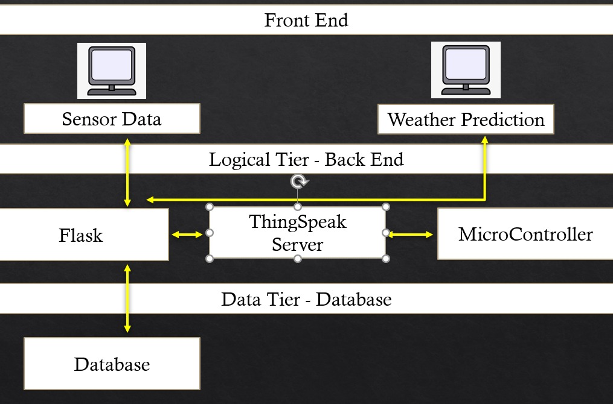



ML - Weather
Design Of the System
Architecture of ML - Weather. Three-tiered design separates presentation, logic, and data for scalability and reuse.
Tiered Architecture Design
01
Presentation Tier
Front End
02
Logical Tier
Back End
03
Data Tier
Data Base
Sensors

Slide 6
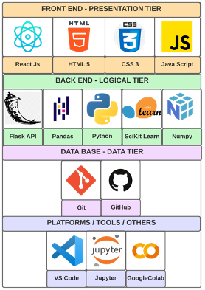






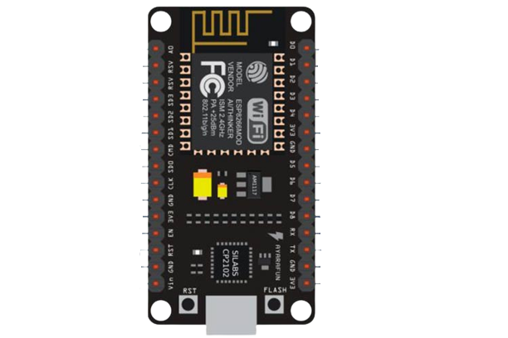
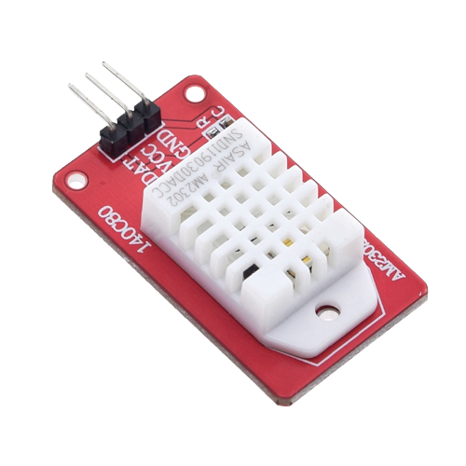
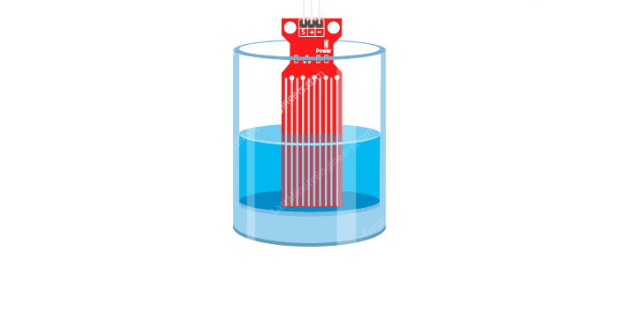


ML - Weather
Technology Selection
The technology stack utilized to build the core library and the Graphical User Interface prototype
Technology Stack
01
Presentation Tier
02
Logical Tier
03
Data Tier

Slide 7
ML - Weather
Demonstration of Prototype
Let's begin.

Slide 8
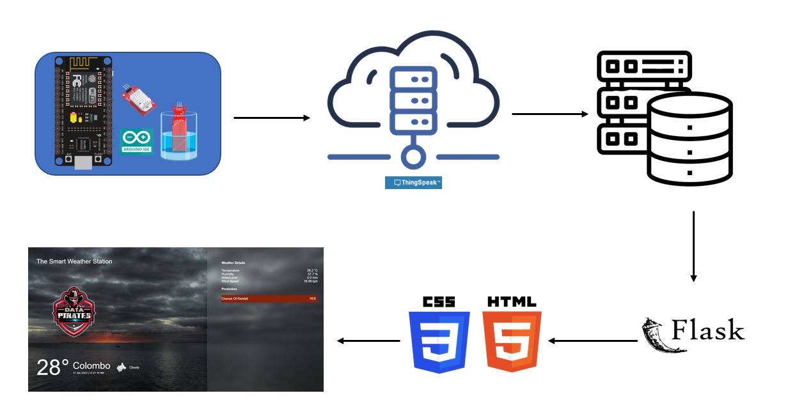
ML - Weather

Slide 9
ML - Weather
Future Enhancement
Limitation
Machine Learning Prediction Using Our Own Data
01
To make ML- Weather a comprehensive program, it should use our own dataset that contains the data received from the embedded device.
01
Error Factor in Sensors Over Time
The sensors could be less efficient after a long time of usage under harsh conditions. Thus , maintenance is required
Auto Removal Of Water From Rain Gauge
02
02
Need Maintenance
To make the rain gauge automatically remove water every midnight.
Need checking and maintenance of the embedded device. The LED light detects the failure of the DHT sensor.
03
SMS Alert for Rainfall, Wind Speed
03
Data scarcity constraints
To make the system send alert messages to mobile numbers registered to the device within a limited range of area upon heavy rainfall possibility or heavy winds.
Not accessible to all the data that contributes to the prediction

Slide 10


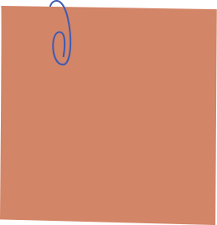
Conclusion
New Skill Acquired
Use of Existing skills
Machine Learning
Python
JavaScript
Learned machine learning for our project
Enhanced the knowledge of machine learning
Python used as primary language to develop the ML models
HTML,CSS used to develop the frontend
Faced Problems
Contribution
Data Loss
Self - study New Tech
Meteorological Department
Existing Systems
Took a bit time to learn the new techniques and libraries and integrate the sensors.
The existing systems can use this system to enhanced their systems and make them accurate.
ML - Weather

Slide 11
That's a wrap!
Thank You
ML - Weather

